Slide 1
Diabetes Prediction System
Using Logistic Regression
AI Lab No 2
From: M Haroon Abbas (2K23/BLCS/38) Course Instructor: Dr Fozia Talpur

Slide 2
Lab Objective
Build an end-to-end diabetes prediction system from data to deployment
Predict diabetes (0/1) from 8 clinical features
Use Pima Indians dataset (768 patients)
Deploy via FastAPI with web interface

Slide 3
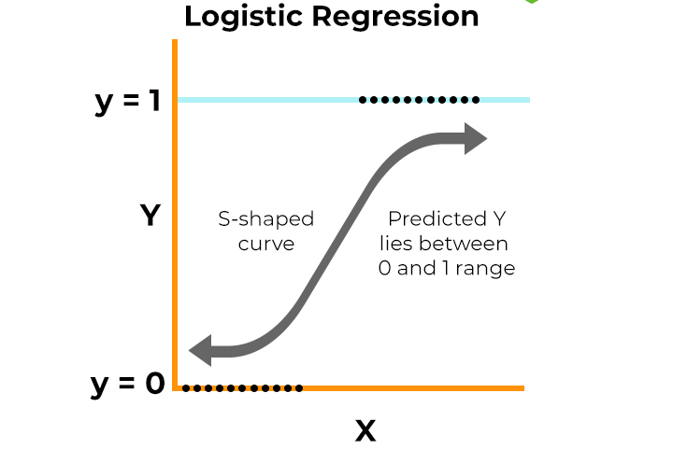
Algorithm: Logistic Regression
Linear model for binary classification (0 or 1)
Outputs probability using sigmoid function
Fast, interpretable, works well for medical data
Enables threshold tuning for Recall optimization

Slide 4
Sigmoid Function
Converts linear combination to probability [0, 1]
σ(z) = 1 / (1 + e)
If probability ≥ threshold → predict 1 (diabetes)

Slide 5
Step 1-2: Load and Split
Load diabetes.csv (768 rows, 8 features + target)
Check for zeros (represent missing values)
Split: Train 70%, Validation 15%, Test 15%
Stratify to preserve class balance (65% vs 35%)

Slide 6
Step 3-4: Preprocess and Train
Replace zeros with NaN in clinical features
Median imputation + StandardScaler (Pipeline)
Train Logistic Regression with GridSearchCV
Tune regularization parameter C using 5-fold CV

Slide 7
Step 5-6: Tune Threshold and Save
Use validation set to find optimal threshold
Lower threshold → Higher Recall (catch more cases)
Save model, threshold, feature names as .pkl

Slide 8
Model Performance
Test set results with tuned threshold:
Model: Logistic Regression Tuning: GridSearchCV (C parameter)
Default Threshold: 0.50 Best Threshold: 0.25 (F1 optimized)
Final Performance:
Accuracy: 76.7%
Precision: 62.5%
Recall: 85.4%
F1 Score: 0.72
Insight
Threshold tuning significantly improved diabetic detection while maintaining acceptable precision.
Lower precision is acceptable because in medical screening (like diabetes), it’s more important to catch as many true patients as possible (high recall), even if it means some healthy people are falsely flagged.

Slide 9
Why This Is Good
High Recall means fewer missed diabetic patients
AUC above 0.80 shows strong predictive power
Simple model = fast inference and interpretability
Threshold tuning aligns with medical priorities

Slide 10
Thank You!
Questions?

